Slide 1

Airfield Operations Division
Wayne County Airport Authority
FAR 139.303 Taking the DTW Recurrent CBT for Movement Area Drivers
March 2022

Slide 2
Topics
Overview of Recurrent CBT
Your Responsibilities
Starting the Recurrent CBT
Taking the Recurrent CBT – Knowledge Checks
Taking the Recurrent CBT – Runway Incursions Exercise
Taking the Recurrent CBT – Overview of Point-to-Point Exercise
  Communicating with Air Traffic Control (ATC)
  Following the Route Given by ATC
  Using Airfield Signs and Markings
Taking the Recurrent CBT - Map Test
Administrative Details

Slide 3
Overview of Recurrent CBT
The purpose of this presentation is to familiarize you with the Recurrent Computer Based Training (CBT) for airfield drivers.
To drive a vehicle on the movement area unescorted, you must complete recurrent driver training at least once every 12 consecutive calendar months.
  NOTE: the definition of “vehicle” includes tug-tow and run-taxi (TT/RT) operations.
    This presentation and the requirements in it apply to persons who perform those operations also.
The CBT tests your abilities to recognize and use airfield markings, lighting, and signs to navigate the airfield while communicating with ATC.
It also tests your knowledge of runway incursions and surface incidents.
Grading for the practical exercises and map test is done electronically and results are instantly transmitted to the WCAA Airfield Operations Training Office (AOTO).
Touch-screen technology is used for all interactions with the Recurrent CBT (no keyboard or mouse).

Slide 4
Your Responsibilities
  Compliance with the 12 Consecutive Calendar Month requirement
  To drive on the movement area unescorted, you must complete recurrent driver training at least once every 12 consecutive calendar months.
  This means that you must complete the recurrent CBT during the month your security badge is due for renewal (your birth month).
  You cannot renew your badge and take the CBT earlier than the first day of your birth month.
    Example: your badge must be renewed in May.
    You must wait until at least May 1 to renew it and take the CBT.

Slide 5
Your Responsibilities (continued)
  Compliance with 12 Consecutive Calendar Month requirement
  If you do not complete/pass the Recurrent CBT when you renew your security badge:
    You will not be issued a new security badge.
    Security will return to you your old badge (the badge that you turned in when you checked in), it will still be valid only until the end of the month.
    You will have to make an appointment to return to Security and complete the CBT.
    You must complete the CBT by the last business day of the month.
    If you do not complete the CBT by the last business day of the month:
      You are prohibited from driving unescorted on the movement area.
      Your security badge will be suspended and you will not have access to the AOA.

Slide 6

Your Responsibilities (continued)
  Compliance with 12 Consecutive Calendar Month requirement
    You will have to make a new appointment to go to Security and take the CBT.
    Once you pass the CBT, you will be issued a new badge with the icon on it, and you can drive unescorted on the movement area again.
    If you drive on the movement area unescorted and your training is not current, you are subject to:
      A fine up to $1,000 per violation.
      Temporary or permanent suspension or revocation of your security badge.
    If you are no longer driving a vehicle unescorted on the movement area:
      Your Department director/employer or company trainer must notify the Airfield Operations Training Office in writing.
      The icon will be removed from your security badge the next time you renew it.

Slide 7
Your Responsibilities (continued)
  Cheating
  The CBT is a “closed book” test. No references are allowed while taking it, except you may take a copy of this presentation into the Credentials Training room to assist you with taking the CBT.
  Otherwise, the following actions are considered cheating and are strictly prohibited:
    Bringing or using any other reference materials (maps, manuals, etc).
    Using a cell phone, tablet, or other electronic device to refer to any reference materials or to call someone for assistance.
    Collaborating with or assisting other test-takers.
    Taking the CBT for another person.
    Looking at the screens of other test-takers.
    Any other actions that are commonly considered “cheating.”
  The airfield driving privileges of a person caught cheating will be
  PERMANENTLY REVOKED and/or an administrative FINE imposed.

Slide 8
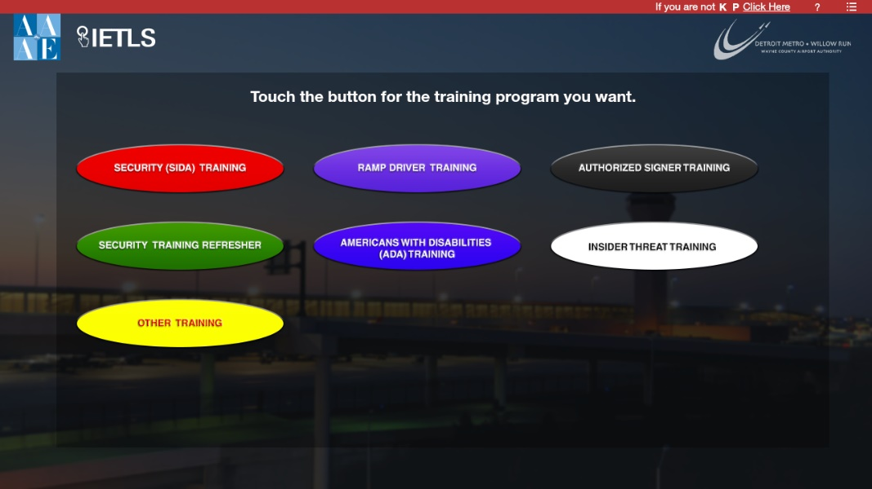
Starting the Recurrent CBT
When you check in at the Credentials front desk, tell the desk person that you need to take the recurrent movement area driver training.
Touch “OTHER TRAINING” (yellow oval)

Slide 9
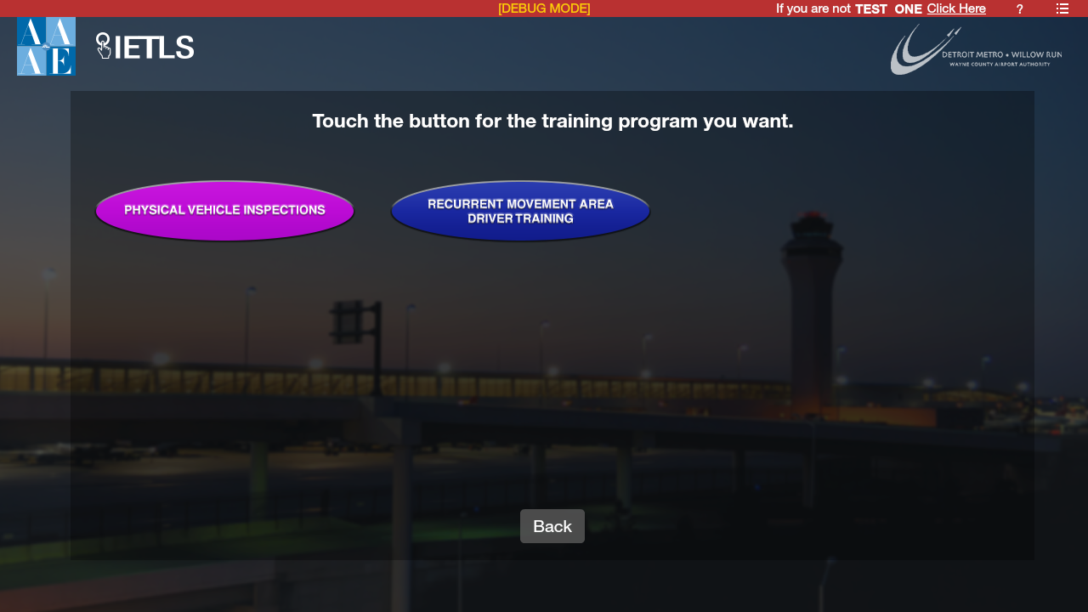
Starting the Recurrent CBT
Touch “RECURRENT MOVEMENT AREA DRIVER TRAINING” (blue oval)

Slide 10
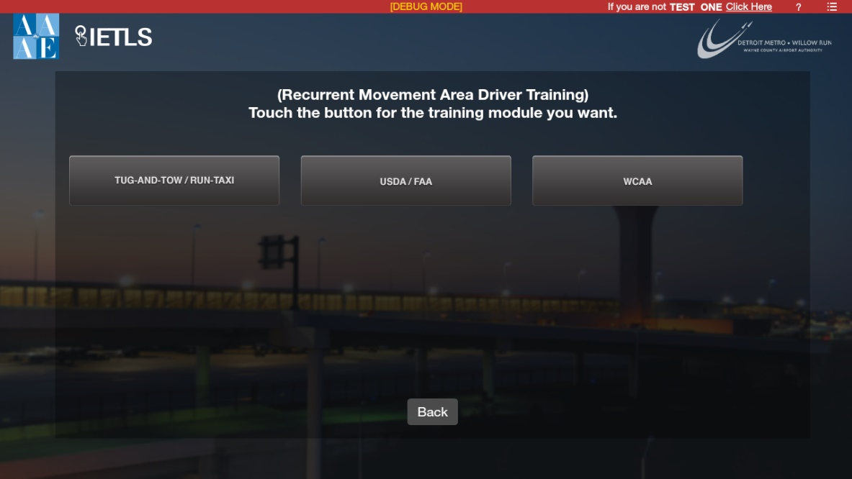
Starting the Recurrent CBT (continued)
Select the group that you are with.

Slide 11
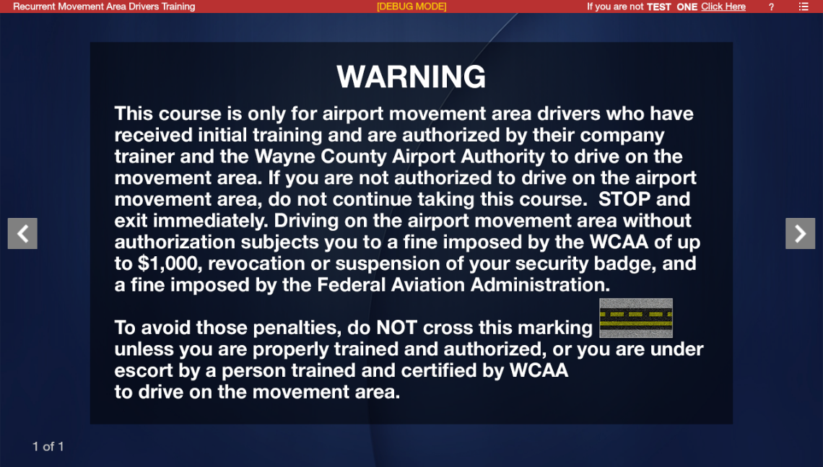
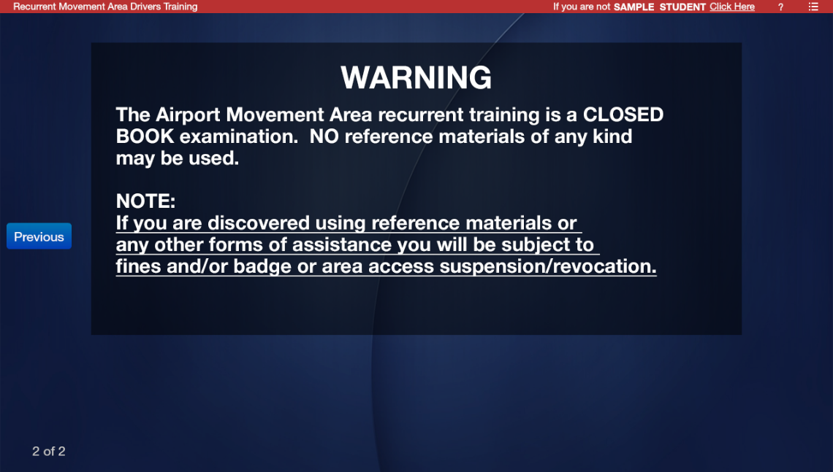
Starting the Recurrent CBT (continued)
This warning screen will appear. Click on the right-hand button.
Then, this warning screen will appear. Click on the right-hand button.

Slide 12
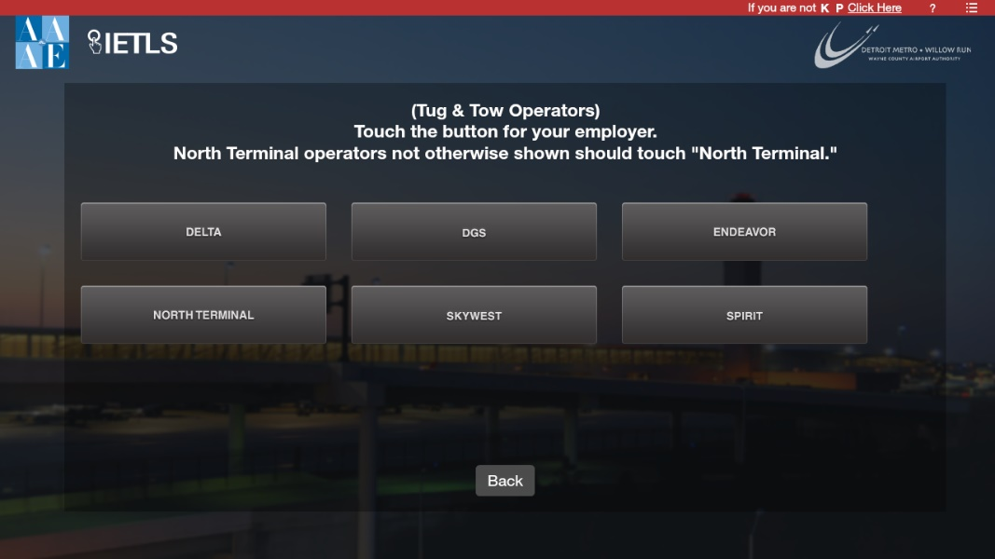
UNIFI

Slide 13
Taking the Recurrent CBT – Knowledge Checks
Knowledge checks are built into the CBT to test you on topics such as lights, signs, and markings.
Each knowledge check is a question that you can take as many times as needed to answer it correctly.
Questions are generated randomly.
There is no limit on the number of times you can retake the CBT, but you must pass it by the last business day of the month in which you renew your security badge.
You are responsible for studying for the knowledge checks and map test.

Slide 14
Taking the Recurrent CBT – Knowledge Checks
The following applies to WCAA employees only.
The materials are available in LMS. To access them:
  Go to your LMS Home Page.
  Click on the “Search for training” icon.
  In the “Search for learning” box, type “Taking the Recurrent CBT” and hit “Enter.”
  You can also find materials by clicking on the “SUBJECT” dropdown (left side of the page). Click on the subject that starts with “139.303.”
  Click on the training material you want to view.
  The materials are also available in your LMS transcript if you have already taken them at least once.

Slide 15



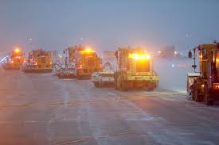
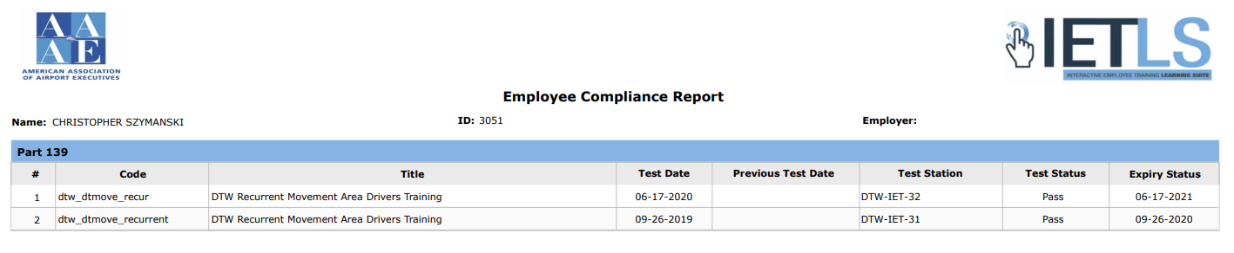
Prerequisites to Operate a Vehicle on the Movement Area
Vehicle operators must have:
a valid and current state-issued driver’s license, not suspended or revoked.
a valid and current airport security badge issued by Airport Security, not suspended or revoked.
a valid reason for entering the movement area (must be related to work duties that have to be performed on the movement area).
a current training date (no more than 12 consecutive calendar months since date of previous training).
Airport Authority
DTW 00/00
Doe,
John

Slide 16
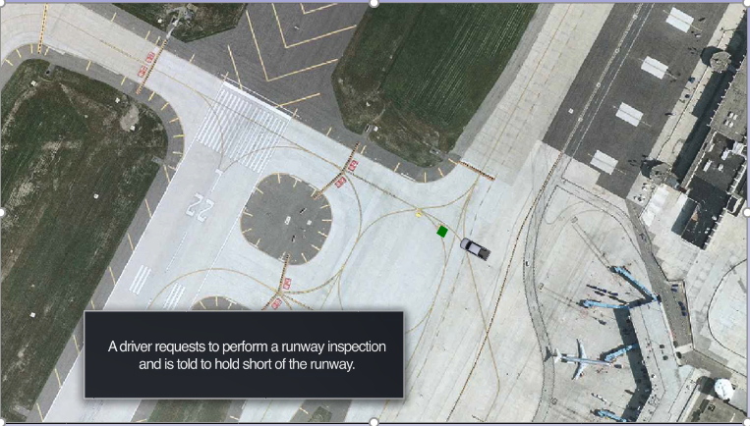
Taking the Recurrent CBT – Runway Incursions Exercise
You will be presented with several runway incursion and surface incident scenarios.
You will answer questions regarding each scenario.
The picture below shows the beginning of one of the scenarios.

Slide 17
Taking the Recurrent CBT – Overview of Point-to-Point Exercise
You will take a Point-to-Point Exercise that consists of three parts:
  Communicating with Air Traffic Control (ATC)
  Following the Route Given by ATC
  Using Signs and Markings to Navigate the Route

Slide 18
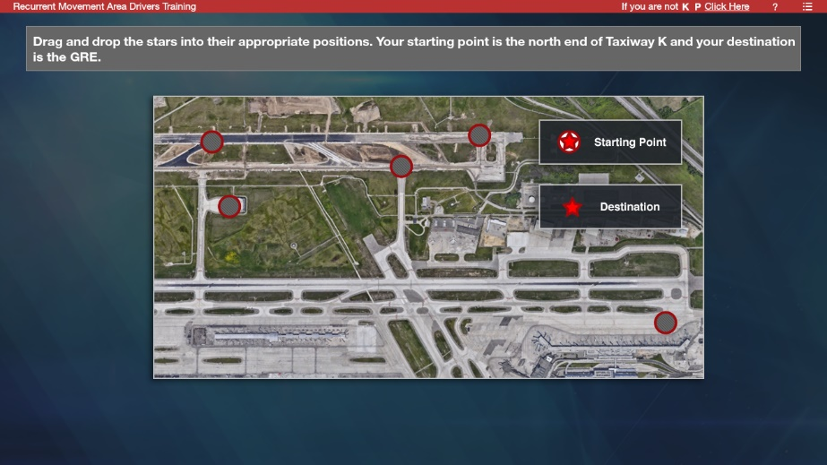
Taking the Recurrent CBT – Communicating with ATC
    You will be given your starting point and destination.
    On the map, identify the starting point and destination by dragging and dropping the red stars at the appropriate locations.
    With your route information and location on the airfield you will select the correct radio frequency.

Slide 19
Taking the Recurrent CBT – Communicating with ATC (continued)
    This is the start of the communication-navigation and point-to-point exercise.
    You are driving “Car 375.”
    You will be asked questions about radio transmissions.
    Select the correct transmission and click submit.

Slide 20
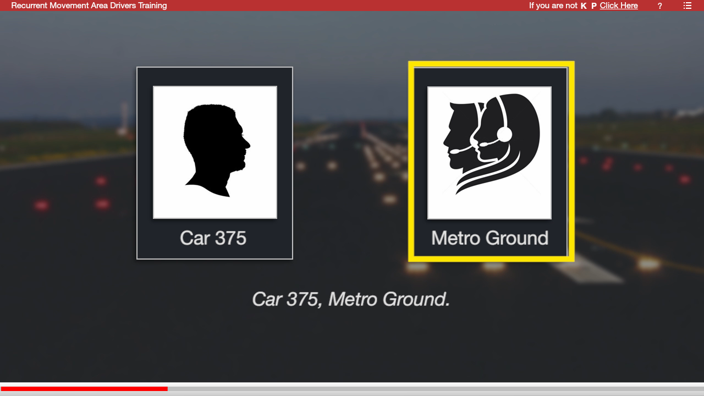
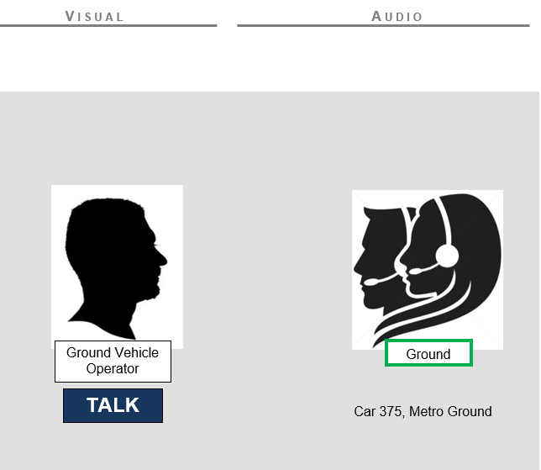
Taking the Recurrent CBT – Communicating with ATC (continued)
The ATC response will automatically appear on the screen.
You will continue throughout the exercise to “communicate” with ATC by selecting the correct transmissions.

Slide 21
Taking the Recurrent CBT – Using Markings
  Airfield markings help you navigate your way around the airfield and warn you about the locations of protected areas such as runways.
  This part of the exercise will test your ability to identify and use airfield markings.
  You will start on the non-movement area at the north end of Twy K.
You will touch an empty box and then touch the marking you would like to place there from the choices that appear.
  You will have several choices for each marking. Make sure you orient the marking properly.
    For example, the non-movement area boundary must be oriented so you cross the solid line first.
    See the next three slides for a demonstration.

Slide 22
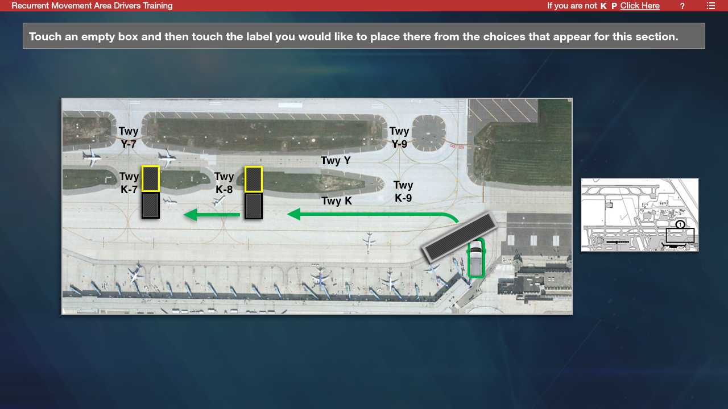
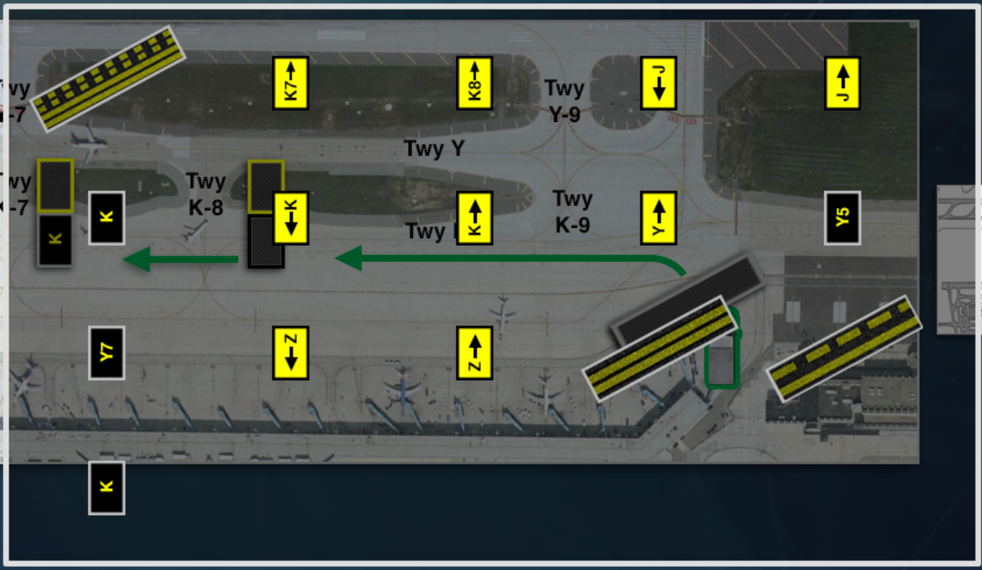

Taking the Recurrent CBT – Markings Exercise
Touch an empty box.
A number of choices will appear.
Touch the marking that you want to place there.
Submit
Reset

Slide 23

Taking the Recurrent CBT – Markings Exercise
The marking will appear in the box you touched.
Once you have filled in all the boxes, touch “Submit.”
Submit
Reset
Submit
Reset

Slide 24
Taking the Recurrent CBT – Markings Exercise
A red box will appear around the box after you have touched “Submit” if you selected an incorrect marking.
Touch the box again, answers will reappear.
Or touch “Reset” to do everything over again.
Once you have filled in all the boxes, touch “Submit.”
Submit
Reset

Slide 25
Taking the Recurrent CBT – Using Signs
  When driving on the airfield, you use taxiway location and directional signs to navigate your way around the airfield.
  This part of the exercise tests your ability to recognize and use signs.
  You will touch an empty box and then touch the sign you would like to place there from the choices that appear.
  Each box is color-coded for the type of sign that should be placed there.
  You must place each sign in the proper position relative to the taxiway the sign refers to.
  Remember that a taxiway directional sign is always placed before the surface it refers to.
    See the next three slides for a demonstration.
Yellow bordered box for taxiway directional sign
Black box for taxiway location sign

Slide 26
Taking the Recurrent CBT – Signs Exercise
Touch an empty box.
A number of choices will appear.
Touch the sign that you want to place there.
Submit
Reset

Slide 27

Taking the Recurrent CBT – Signs Exercise
The sign will appear in the box you touched.
Once you have filled in all the boxes, touch “Submit.”
Submit
Reset

Slide 28
Taking the Recurrent CBT – Signs Exercise
A red box will appear around the box after you have touched “Submit” if you selected an incorrect sign.
Touch the box again, answers will reappear.
Or touch “Reset” to do everything over again.
Once you have filled in all the boxes, touch “Submit.”
Submit
Reset

Slide 29
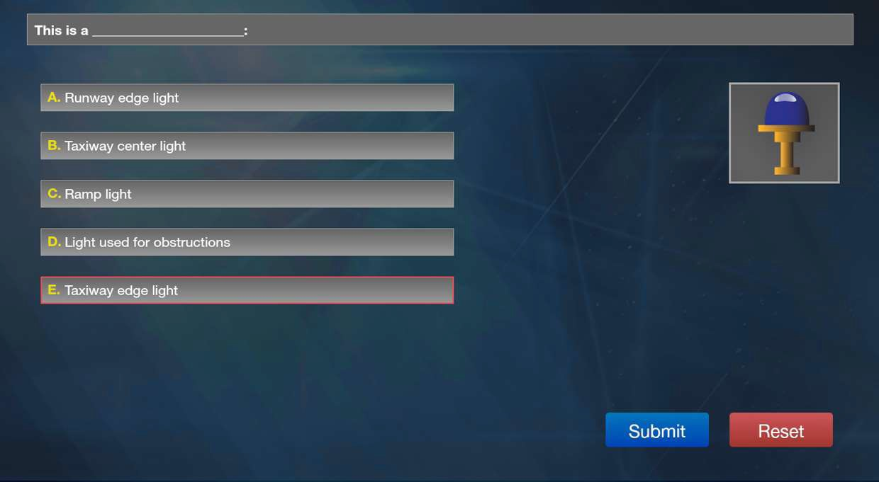
Taking the Recurrent CBT – Knowledge Checks
  You will be given a number of knowledge checks to answer in the following format. Touch the answer and then touch “Submit.”

Slide 30
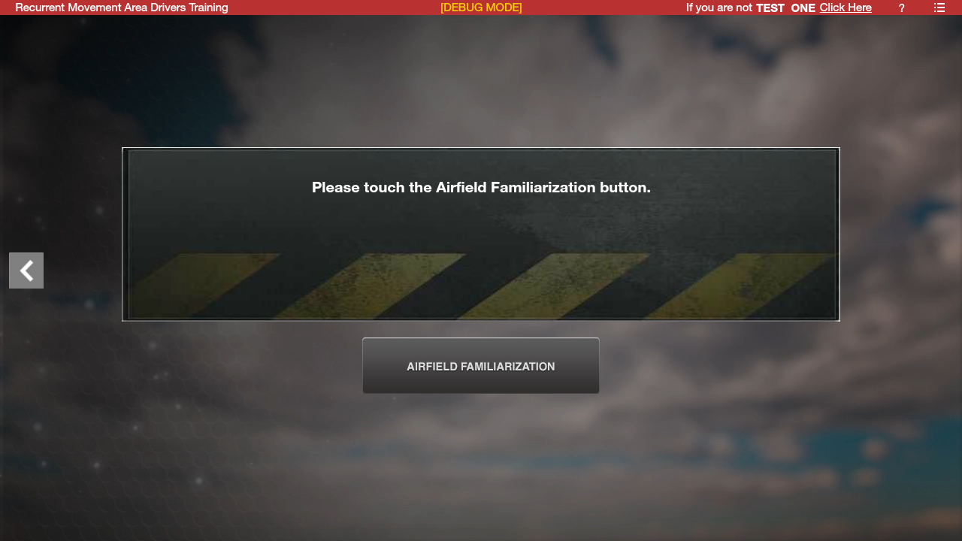
Taking the Recurrent CBT – DTW Map Test
  Once you finish the knowledge checks and exercise, this screen will appear:
  Click on the Airfield Familiarization button.

Slide 31
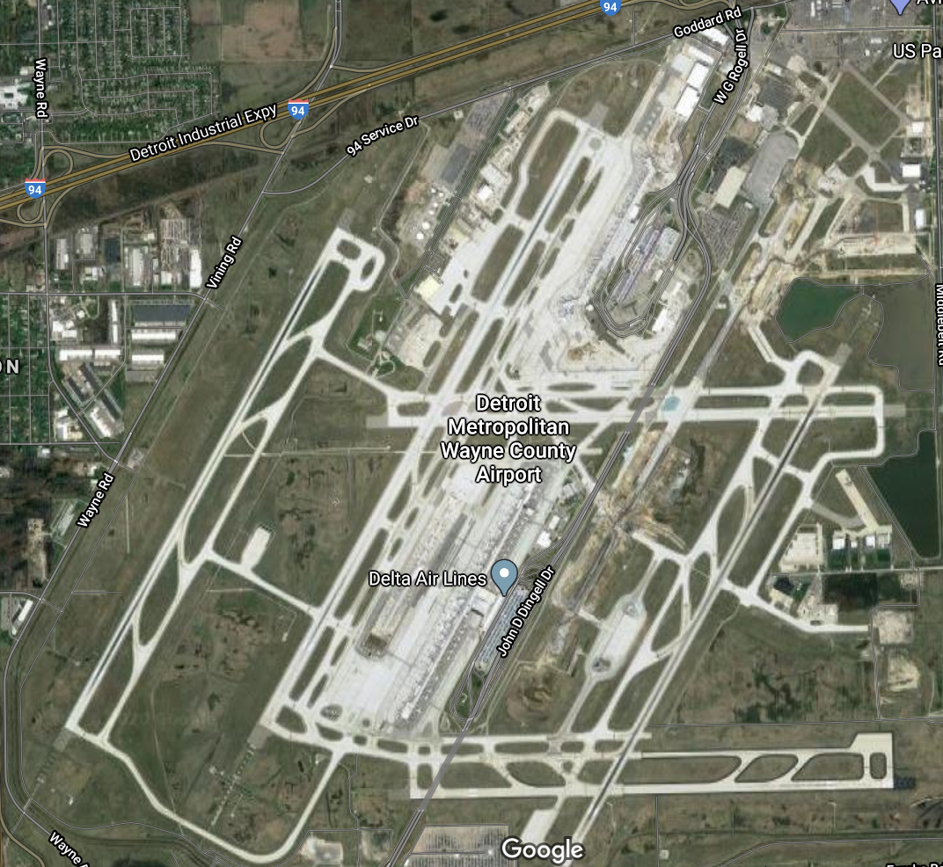
Taking the Recurrent CBT – DTW Map Test
  The map test uses an aerial photo of the airport.
  The airport is broken up into sections for clarity and detail.
  The passing score on the map test is 90%.

Slide 32
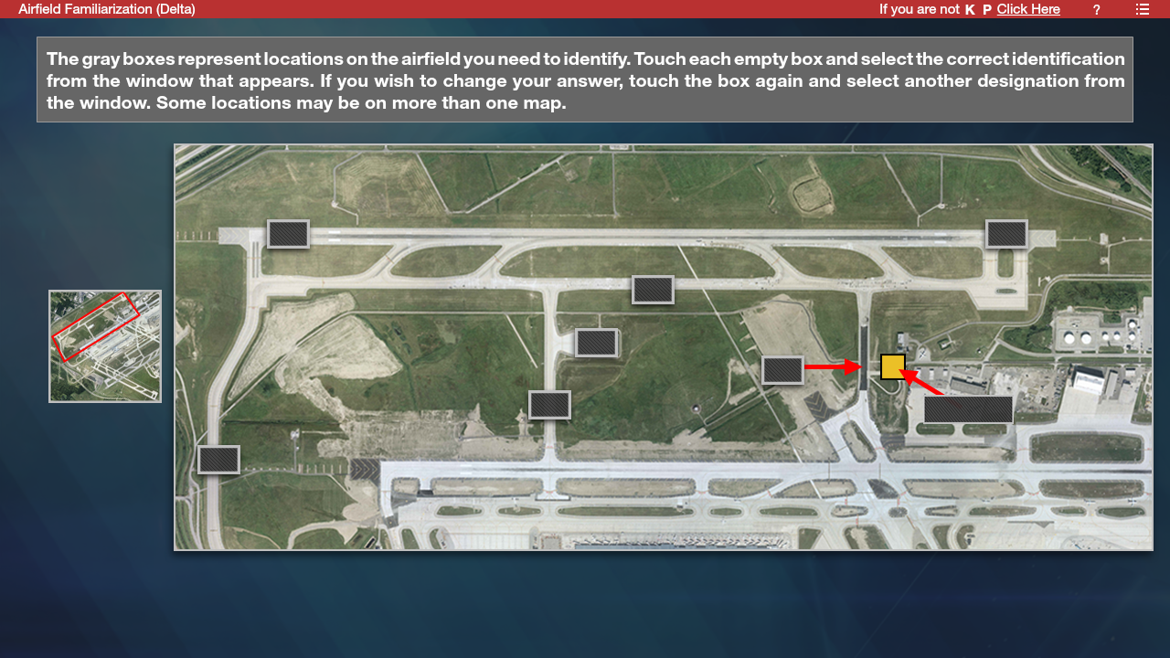
Taking the Recurrent CBT – DTW Map Test
  A map of the entire airport is inserted on the left to help orient you.

Slide 33

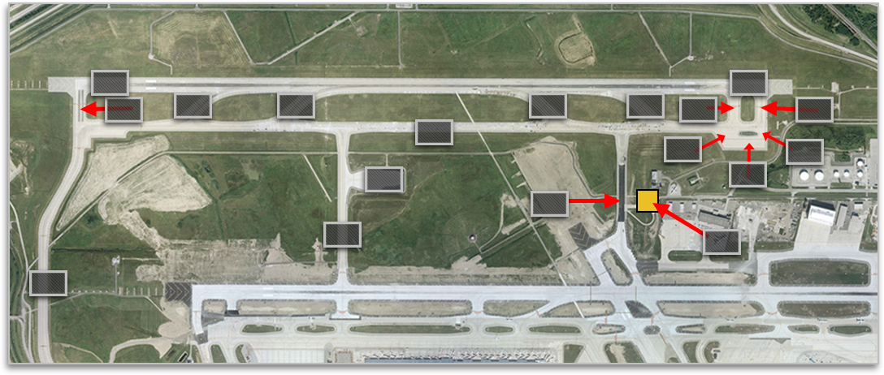
























Taking the Recurrent CBT – DTW Map Test
  One box is located on each surface to be identified. Touch a box.
  Then touch the desired sign to identify the surface. It will appear.
  If you make a mistake when selecting an answer, touch the box again and then touch the desired sign.
The sign will appear

Slide 34
Taking the Recurrent CBT – DTW Map Test
  Once you have finished a section, you will touch a “Submit” button to submit your answers.
  As with the marking and sign exercises, a red box will appear around any wrong answers.
  Click on the box and repeat the process to correct the answer.

Slide 35
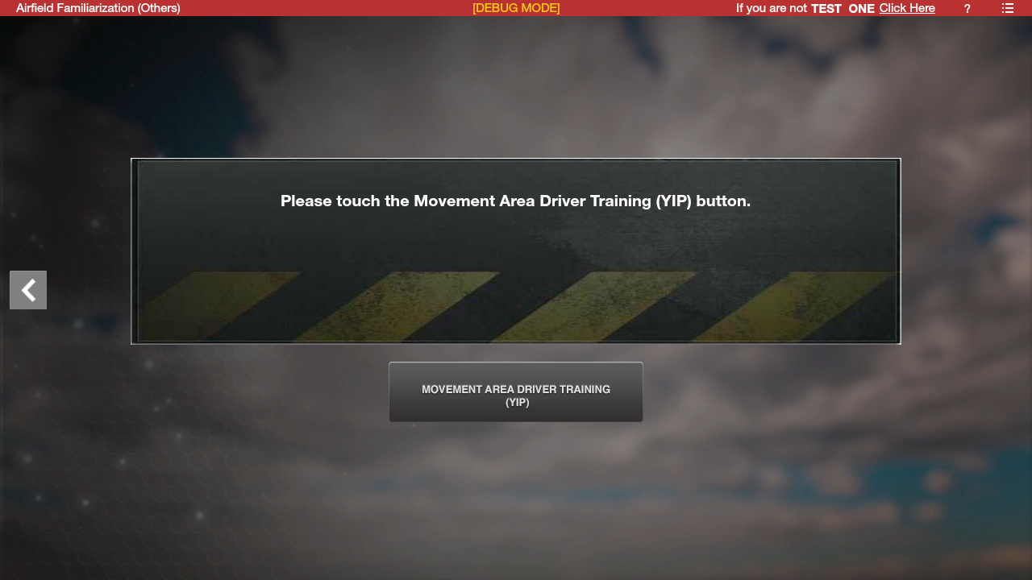
Taking the Recurrent CBT – YIP Map Test
  WCAA employees will also be tested on Willow Run’s map.
  After finishing the DTW map this screen will appear:
  Click on the “Movement Area Driver Training (YIP)” button.

Slide 36
Administrative Details
Failures/retakes
  You can retake the Recurrent CBT as many times as needed to pass.
  If you pass the knowledge checks and exercises, but fail the map test:
    You will be returned to the beginning of the map test to retake it.
    You will not have to retake the knowledge checks and exercises.
  You must return for retakes if you don’t complete the Recurrent CBT by the end of Credential’s work hours.
  There is no limit on the number of retakes, but you must pass the CBT by the last business day of the month.

Slide 37
Administrative Details
For WCAA/FAA/USDA CBT requires about 45 minutes to an hour.
For Tug and Tow/Run-Taxi CBT requires about 75 to 90 minutes.
This time is in addition to the time it takes to take the rest of the Security training.
At this time, you must have an appointment to renew your badge and take the CBT.
Click on https://DTWCredentialsAppointments.as.me/?appointmentType=15522138 to schedule an appointment.
Due to limited seating and space in the lobby, remain in your vehicle until your confirmed appointment time.
You should arrive early enough to begin taking the Recurrent CBT by 2:00 PM
You must complete the Recurrent CBT before Credentials closes or you will have to come back another day to take it.

Slide 38
Administrative Details
  Late renewals
There may be occasions where you cannot renew your badge and take the Recurrent CBT by the end of your birth month (for example, medical leave).
Your Department head/employer/company trainer must notify Airfield Operations Training when:
  Your absence begins.
  You return and are ready to renew your security badge.
You will take the Recurrent CBT if renewal is late by six months or less.
You will have to retake full initial training if your renewal is late by more than six months.

Slide 39
Administrative Details
  Questions/comments?
  The CBT was developed and is maintained by the WCAA Airfield Operations Training Office (AOTO).
  Questions and comments about recurrent driver training requirements and the content of the CBT must be directed to the AOTO.
  Security personnel did not play a role in developing the CBT and will not be able to answer questions and comments about it.
  Tug-Tow/Run-Taxi employees – contact your company trainer, they will contact the AOTO.
  WCAA, FAA Tech Ops, and USDA employees - contact the AOTO.
  The AOTO can be reached during normal business hours at 734-942-3595 or email AMA.driver.training@wcaa.us

Slide 40

Thank you!
WCAA Airfield Training Office
734-942-3595

