Slide 1

Airfield Operations Division
Wayne County Airport Authority
FAR 139.303 and 139.329 Map Test Screen Shots for the Recurrent CBT for DTW Airport Movement Area Drivers
October 2020

Slide 2
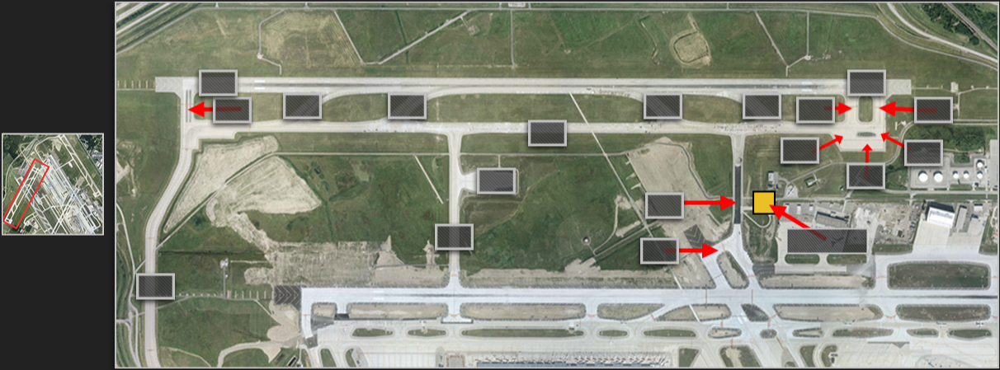
WCAA FAA USDA
Map 1
These screen shots show you what the map test in the new Computer-Based Training (CBT) for Airfield Drivers looks like. The test reflect all of the changes to the airfield as of the end of the 2020 construction season.

Slide 3
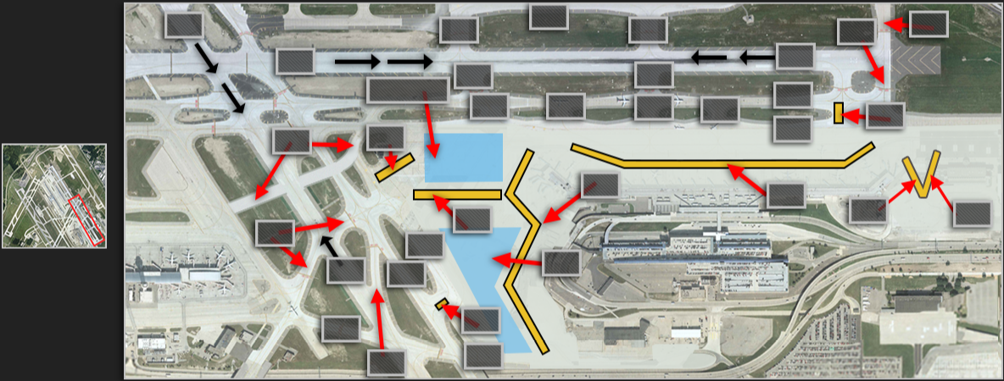
WCAA FAA USDA
Map 2

Slide 4
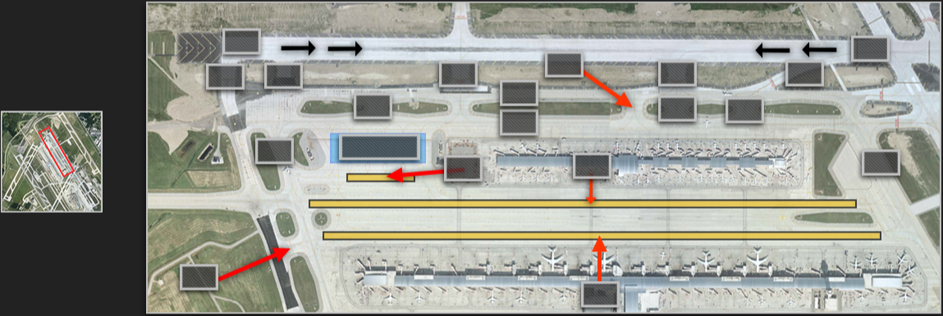
WCAA FAA USDA
Map 3

Slide 5
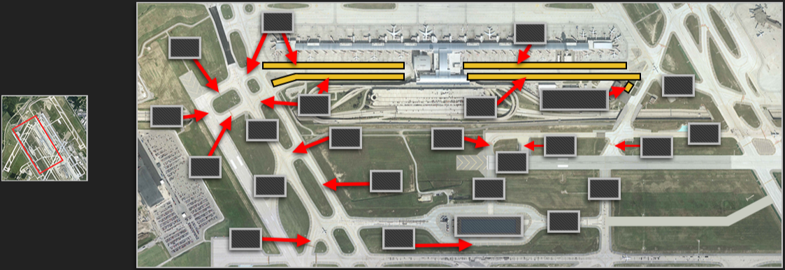
WCAA FAA USDA
Map 4

Slide 6
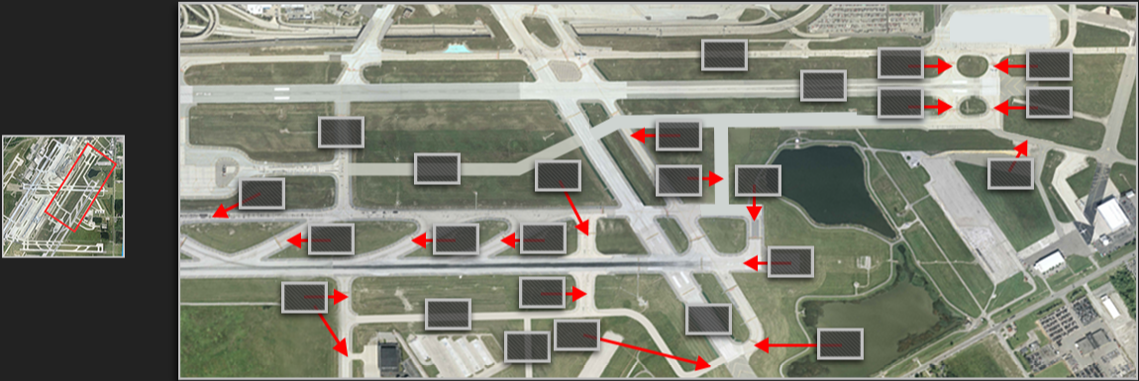
WCAA FAA USDA
Map 5

Slide 7
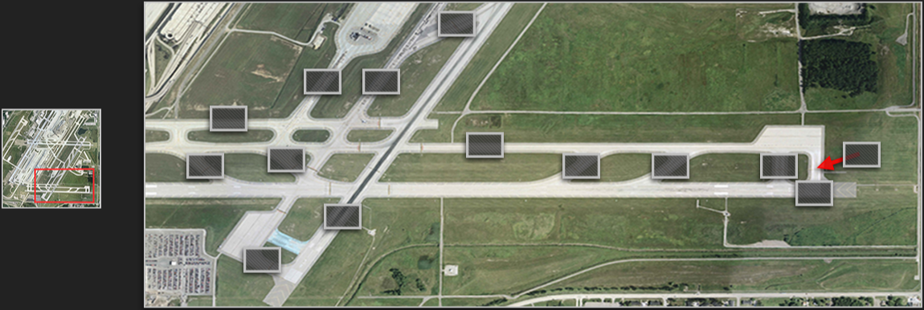
WCAA FAA USDA
Map 6

